Slide 1
DYNAMIC WEATHER DASHBOARD
CAPSTONE PROJECT
Presented By: Rohitha kavala
1. Student Name-College Name-Department: Rohitha kavala – V.S.M College of Engineering – Computer science engineering

Slide 2
OUTLINE
Problem Statement
System Development Approach (Technology Used)
Algorithm & Deployment (Step by Step Procedure)
Result
Conclusion
Future Scope
Locations

Slide 3
Problem Statement
Weather conditions are unpredictable and directly affect daily life, travel, agriculture, and outdoor activities.
Many people rely on quick and accurate weather updates to make decisions, but existing solutions are either too complex
or require app installation.
Some weather apps show unnecessary advertisements or cluttered data, making it harder for users to get the information
they need.
Lack of lightweight, browser-based dashboards that work instantly without installation.
Users often need location-based updates without manually searching every time.
Current platforms may not always provide an easy-to-read 5-day forecast.
Responsive access is often missing — many weather sites are not well optimized for mobile devices.
There is a need for a simple, user-friendly, and fast interface that works across all devices.

Slide 4
System Approach
Frontend Languages: HTML, CSS, JavaScript
APIs Used: OpenWeatherMap API (weather data), Geolocation API (fetch location)
Design Approach: Responsive UI (works on desktop, tablet, and mobile)
Development Style: Step-by-step modular coding (API integration + UI updates)

Slide 5
Algorithm & Deployment
User opens dashboard (via browser).
Geolocation API fetches user’s current location (if permission granted).
Alternatively, user can search for a city in the search bar.
Weather data request sent to OpenWeatherMap API with location/city.
API response (temperature, humidity, conditions, forecast) is received.
Data displayed dynamically on the dashboard (real-time + 5-day forecast).
Responsive CSS ensures it adapts across devices.
Deployment: Project runs by simply opening index.html in a browser.

Slide 6
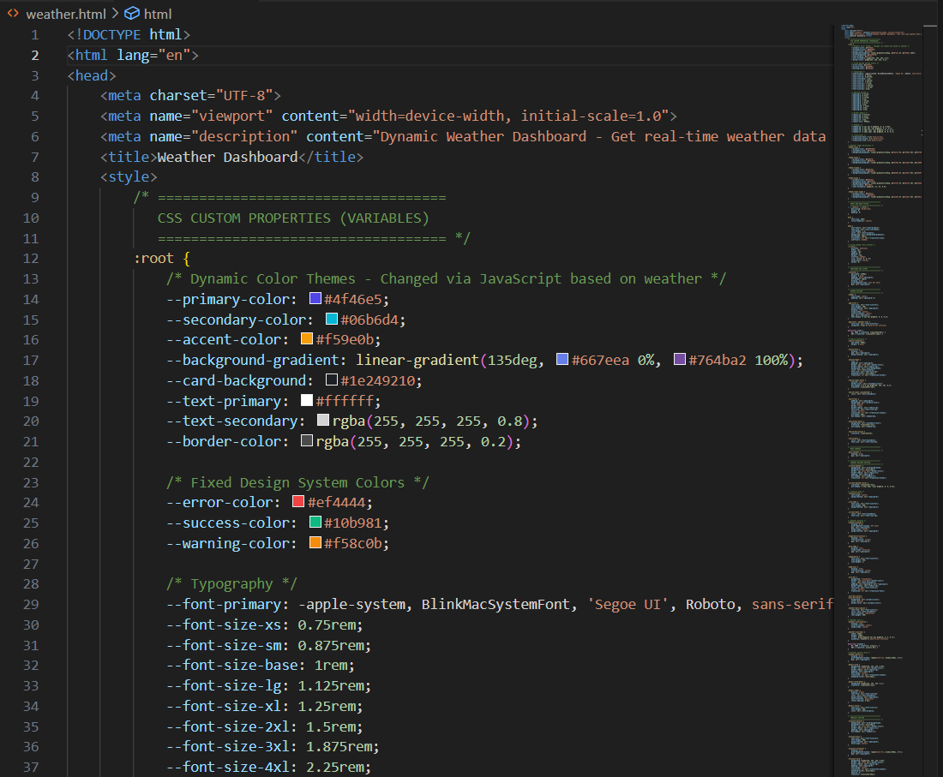

Slide 7
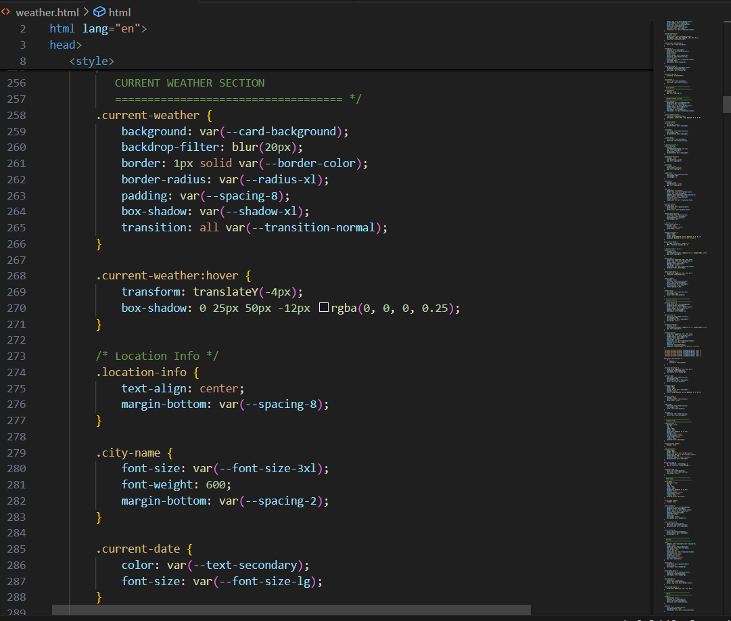

Slide 8
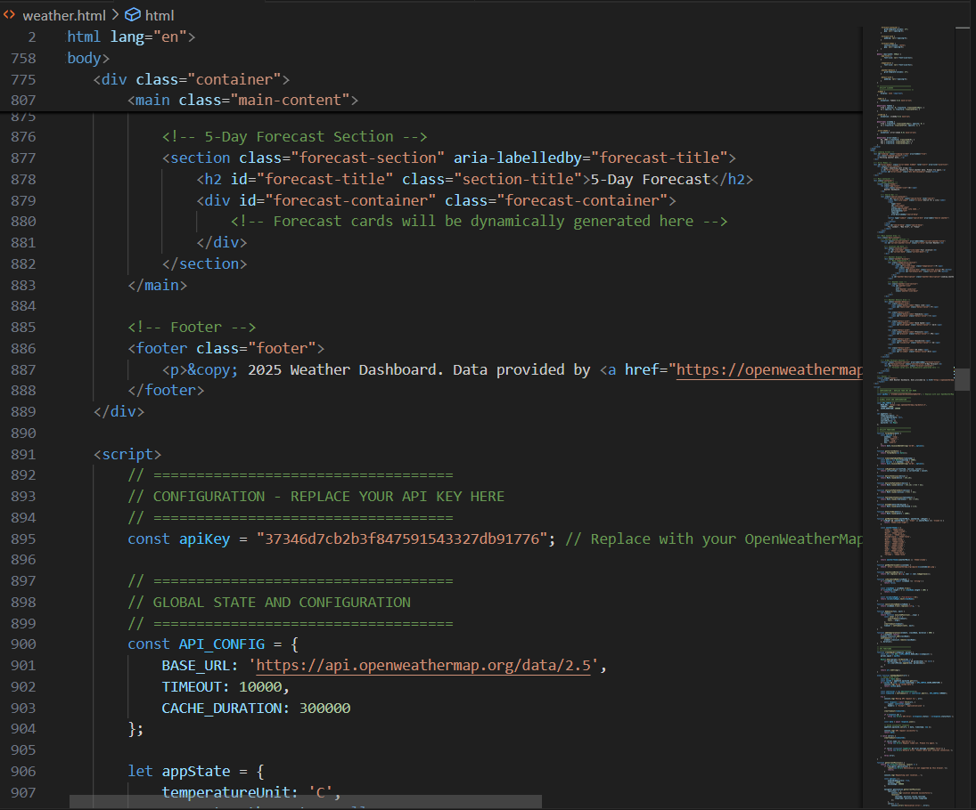

Slide 9
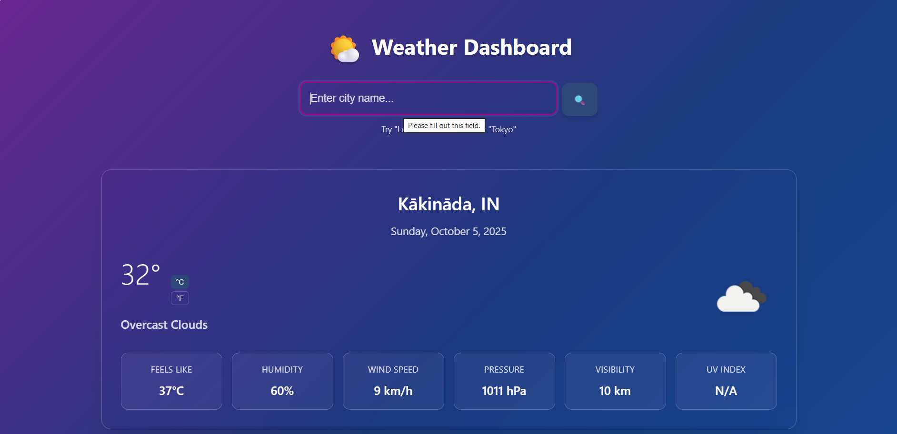
RESULT

Slide 10
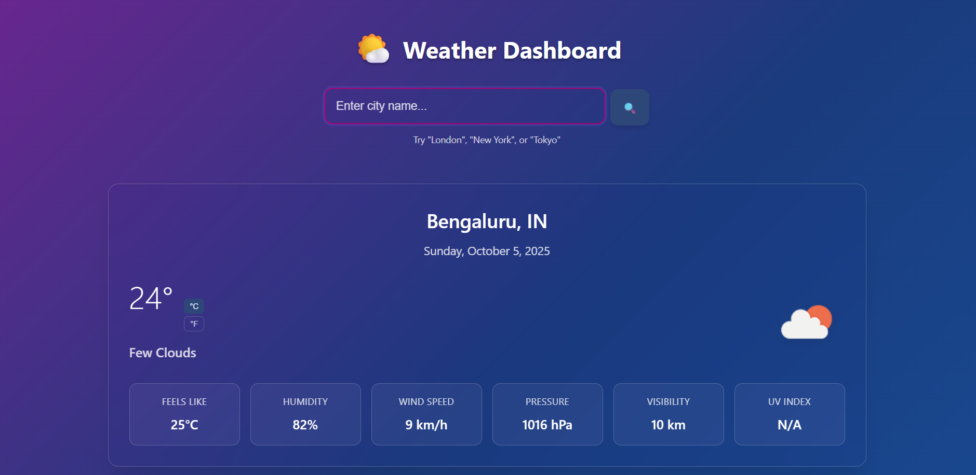

Slide 11
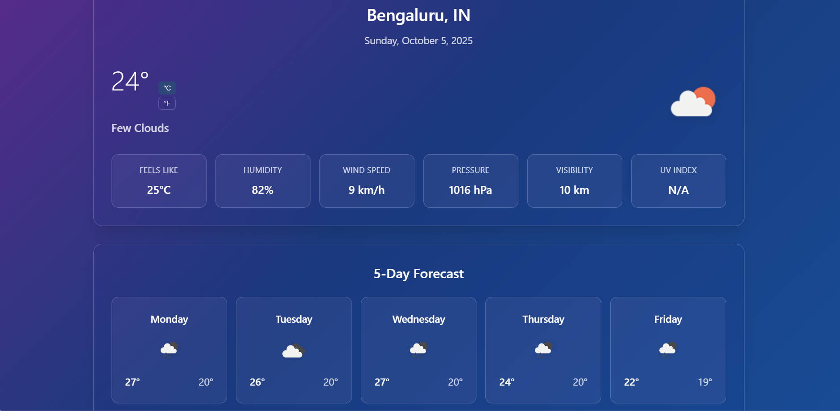

Slide 12
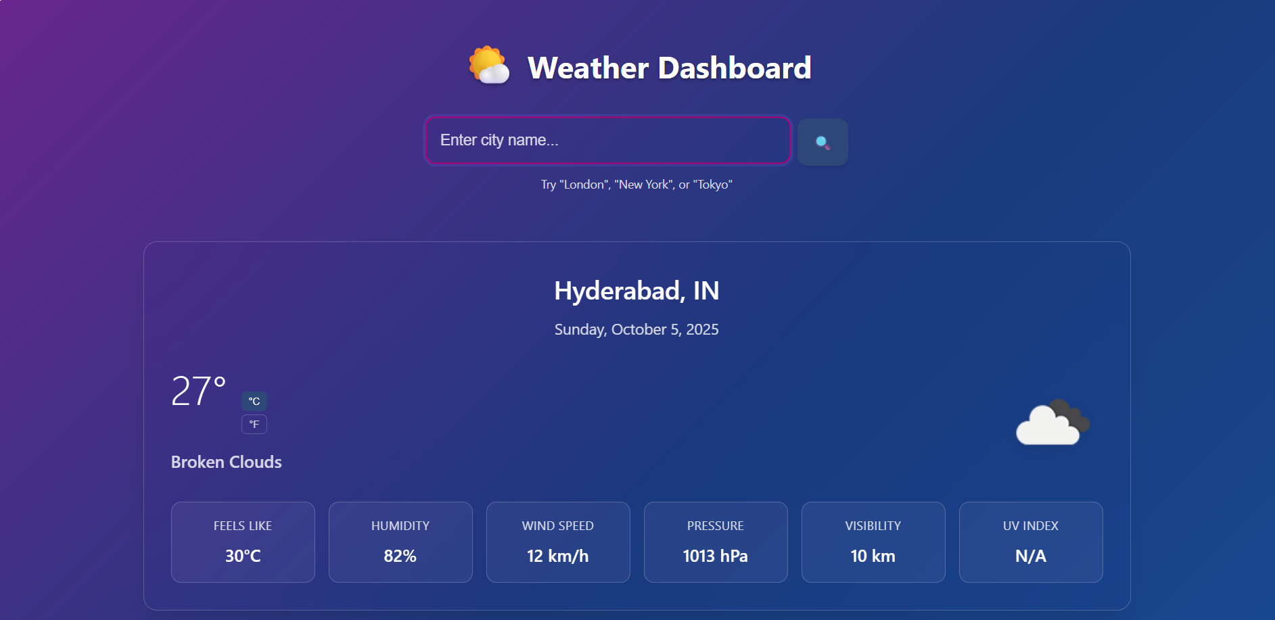
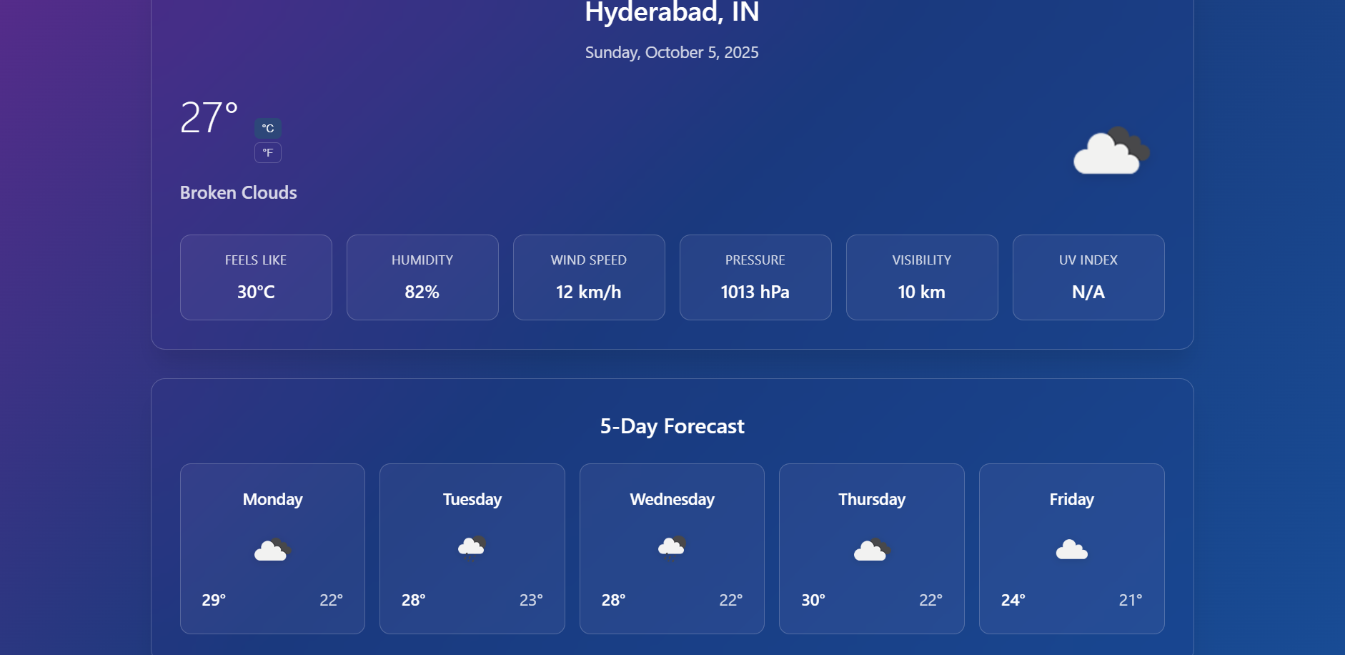

Slide 13
GITHUB AND DEPLOYMNET LINK
Github Link : https://github.com/RohithaKavala/Dynamic-weather-dashboard
Deployment link: https://rohithakavala.github.io/Dynamic-weather-dashboard/

Slide 14
Conclusion
Successfully built a dynamic weather application.
Learned frontend development + API integration.
Demonstrated real-world application of web technologies.

Slide 15
Future scope(Optional)
🌍 Multi-language support.
📊 Advanced charts/graphs for weather trends.
🔔 Push notifications for extreme weather alerts.
📱 Mobile app version for offline support.

Slide 16
References
1. APIs & Libraries
- OpenWeatherMap API: https://openweathermap.org/api
- Chart.js Documentation: https://www.chartjs.org/docs/latest/
2. Learning Resources
- MDN Web Docs: https://developer.mozilla.org/
- W3Schools Tutorials: https://www.w3schools.com/
3. Deployment
- GitHub Pages: https://pages.github.com/

Slide 17
THANK YOU

